Slide 1

HIVE
Aaradhy Sharma​
Ankita Dharurkar​
Dhaval Patel

Slide 2
WHAT IS HIVE ?
Apache Hive is an open-source data warehousing tool for performing distributed processing and data analysis. It was developed by Facebook to reduce the work of writing the Java MapReduce program.
Apache Hive uses a Hive Query language, which is a declarative language similar to SQL. Hive translates the hive queries into MapReduce programs.
It supports developers to perform processing and analyses on structured and semi-structured data by replacing complex java MapReduce programs with hive queries.
One who is familiar with SQL commands can easily write the hive queries.
Hive makes the job easy for performing operations like
Analysis of huge datasets
Ad-hoc queries
Data encapsulation

Slide 3
HIVE ARCHITECTURE
The figure in the next slides shows the architecture of Apache Hive and its major components:
Hive Client
Hive Services
Processing and Resource Management
Distributed Storage

Slide 4
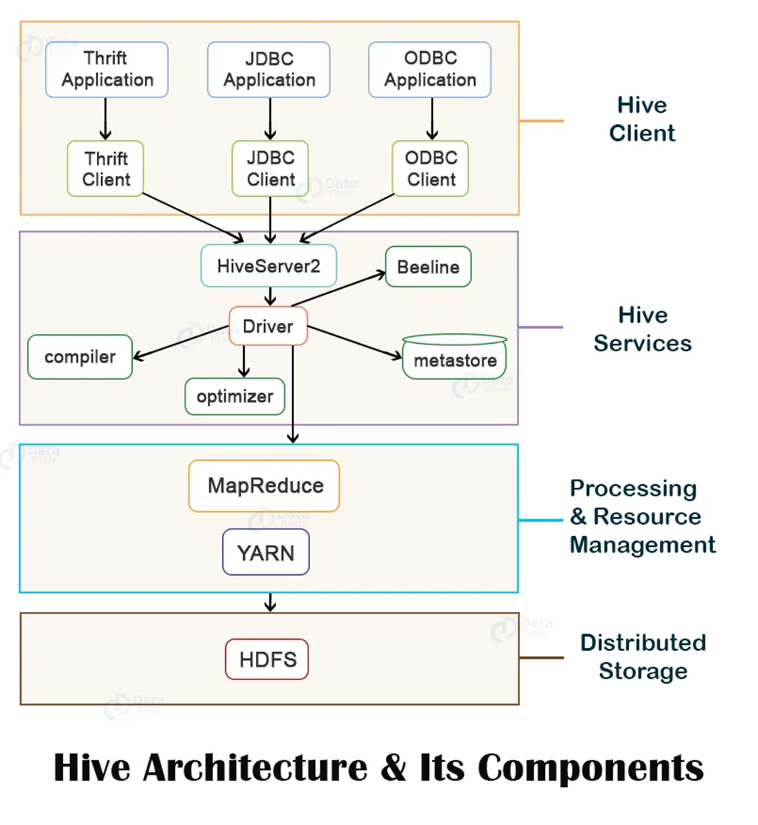
HIVE ARCHITECTURE
Hive Client
Hive supports applications written in any language like Python, Java, C++, Ruby, etc. using JDBC, ODBC, and Thrift drivers, for performing queries on the Hive. Hence, one can easily write a hive client application in any language of its own choice. Hive clients are categorized into three types:
1. Thrift Clients
The Hive server is based on Apache Thrift so that it can serve the request from a thrift client.
2. JDBC client
Hive allows for the Java applications to connect to it using the JDBC driver. JDBC driver uses Thrift to communicate with the Hive Server.
3. ODBC client
Hive ODBC driver allows applications based on the ODBC protocol to connect to Hive. Similar to the JDBC driver, the ODBC driver uses Thrift to communicate with the Hive Server.

Slide 5
HIVE ARCHITECTURE
Hive Service
To perform all queries, Hive provides various services like the Hive server2, Beeline, etc. The various services offered by Hive are:
1. Beeline
The Beeline is a command shell supported by HiveServer2, where the user can submit its queries and command to the system. It is a JDBC client that is based on SQLLINE CLI (pure Java-console-based utility for connecting with relational databases and executing SQL queries).
2. Hive Server 2
HiveServer2 is the successor of HiveServer1. HiveServer2 enables clients to execute queries against the Hive. It allows multiple clients to submit requests to Hive and retrieve the final results. It is basically designed to provide the best support for open API clients like JDBC and ODBC.
3. Driver
The Hive driver receives the HiveQL statements submitted by the user through the command shell. It creates the session handles for the query and sends the query to the compiler.

Slide 6
HIVE ARCHITECTURE
4. Compiler
Hive compiler parses the query. It performs semantic analysis and type-checking on the different query blocks and query expressions by using the metadata stored in metastore and generates an execution plan. The execution plan created by the compiler is the DAG(Directed Acyclic Graph), where each stage is a map/reduce job, operation on HDFS, a metadata operation.
5. Optimizer
Optimizer performs the transformation operations on the execution plan and splits the task to improve efficiency and scalability.
6. Execution Engine
Execution engine, after the compilation and optimization steps, executes the execution plan created by the compiler in order of their dependencies using Hadoop.
7. Metastore Metastore is a central repository that stores the metadata information about the structure of tables and partitions, including column and column type information. It also stores information of serializer and deserializer, required for the read/write operation, and HDFS files where data is stored. This metastore is generally a relational database. Metastore provides a Thrift interface for querying and manipulating Hive metadata. We can configure metastore in any of the two modes:
Remote: In remote mode, metastore is a Thrift service and is useful for non-Java applications.
Embedded: In embedded mode, the client can directly interact with the metastore using JDBC.

Slide 7
HIVE ARCHITECTURE
Processing Framework and Resource Management
Hive internally uses a MapReduce framework as a defacto engine for executing the queries.
MapReduce is a software framework for writing those applications that process a massive amount of data in parallel on the large clusters of commodity hardware. MapReduce job works by splitting data into chunks, which are processed by map-reduce tasks.
Distributed Storage
Hive is built on top of Hadoop, so it uses the underlying Hadoop Distributed File System for the distributed storage.
HIVE SCALABILITY As data variety and volume grows, more commodity machines can be added, without a corresponding reduction in performance.

Slide 8
Security
Hadoop has begun using Kerberos authorization support to provide security.
Kerberos allows for mutual authentication between client and server. In this system, the client’s request for a ticket is passed along with the request.
The previous versions of Hadoop had several issues such as users being able to spoof their username by setting the hadoop.job.ugi property and also MapReduce operations being run under the same user: hadoop or mapred. With Hive v0.7.0’s integration with Hadoop security, these issues have largely been fixed.
TaskTracker jobs are run by the user who launched it and the username can no longer be spoofed by setting the hadoop.job.ugi property.
Permissions for newly created files in Hive are dictated by the HDFS. The HDFS (Hadoop distributed file system) is similar to the Unix file system, where there are three entities: user, group and others with three permissions: read, write and execute. The default permissions for newly created files can be set by changing the umask value for the Hive configuration variable hive.files.umask.value.

Slide 9
Manageability
There is metastore configuration called a remote metastore, where one or more metastore servers run in separate processes to the Hive service. This brings better manageability and security because the database tier can be completely firewalled off, and the clients no longer need the database credentials

Slide 10





Prerequisites
Java 1.7
Users are strongly advised to start moving to Java 1.8
Hadoop 2.x (preferred), 1.x (not supported by Hive 2.0.0 onward).
Hive versions up to 0.13 also supported Hadoop 0.20.x, 0.23.x. Hive is commonly used in production Linux and Windows environment. Mac is a commonly used development environment.
The instructions in this document are applicable to Linux and Mac. Using it on Windows would require slightly different steps.

Slide 11
Benefits and Pitfalls
Benefits
An easy way to process large scale data
Support SQL-based queries
Provide more user defined interfaces to extend
Programmability
Efficient execution plans for performance
Interoperability with other database tools
Pitfalls
No easy way to append data
Files in HDFS are immutable to add text

